Slide 1
Improving Model Performance

Slide 2
Improving model performance with meta-learning
As an alternative to increasing the performance of a single model, it is possible to combine several models to form a powerful team. The technique of combining and managing the predictions of multiple models falls into a wider set of meta-learning methods defining techniques that involve learning how to learn.

Slide 3
Understanding ensembles
Suppose you were a contestant on a television trivia show that allowed you to choose a panel of five friends to assist you with answering the final question for the million-dollar prize. Most people would try to stack the panel with a diverse set of subject matter experts. A panel containing professors of literature, science, history, and art, along with a current pop-culture expert would be a safely well-rounded group. Given their breadth of knowledge, it would be unlikely to find a question that stumps the group.

Slide 4
The meta-learning approach that utilizes a similar principle of creating a varied team of experts is known as an ensemble. All the ensemble methods are based on the idea that by combining multiple weaker learners, a stronger learner is created. The various ensemble methods can be distinguished, in large part, by the answers to these two questions:
How are the weak learning models chosen and/or constructed?
How are the weak learners' predictions combined to make a single final prediction?

Slide 5
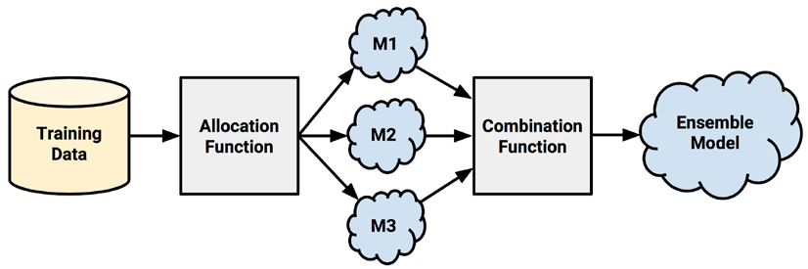

Slide 6
First, input training data is used to build a number of models. The allocation function dictates how much of the training data each model receives.
After the models are constructed, they can be used to generate a set of predictions, which must be managed in some way.
The combination function governs how disagreements among the predictions are reconciled.

Slide 7
For example, suppose that when M1 and M2 both vote yes, the actual class value is usually no. In this case, the ensemble could learn to ignore the vote of M1 and M2 when they agree. This process of using the predictions of several models to train a final arbiter model is known as stacking.

Slide 8
Bagging
One of the first ensemble methods to gain widespread acceptance used a technique called bootstrap aggregating or bagging for short.
Bagging generates a number of training datasets by bootstrap sampling the original training data. These datasets are then used to generate a set of models using a single learning algorithm. The models' predictions are combined using voting (for classification) or averaging (for numeric prediction).

Slide 9
Boosting
Another common ensemble-based method is called boosting because it boosts the performance of weak learners to attain the performance of stronger learners.
Boosting is an ensemble modeling technique that attempts to build a strong classifier from the number of weak classifiers. It is done by building a model by using weak models in series.
Notes:
Similar to bagging, boosting uses ensembles of models trained on resampled data and a vote to determine the final prediction. There are two key distinctions.
First, the resampled datasets in boosting are constructed specifically to generate complementary learners. Second, rather than giving each learner an equal vote, boosting gives each learner's vote a weight based on its past performance.
Models that perform better have greater influence over the ensemble's final prediction.

Slide 10
Firstly, a model is built from the training data. Then the second model is built which tries to correct the errors present in the first model. This procedure is continued and models are added until either the complete training data set is predicted correctly or the maximum number of models is added.

Slide 11
Random forests
Another ensemble-based method called random forests or decision tree forests focuses only on ensembles of decision trees.
Random forests combine versatility and power into a single machine learning approach. As the ensemble uses only a small, random portion of the full feature set, random forests can handle extremely large datasets, where the so-called "curse of dimensionality" might cause other models to fail.

